Slide 1

u
INFO 5871 Fall 19 Intro to Data Science Midterm
An Oscars Demographics’ Data Tour
Keke Wu

Slide 2
01
DATA DESCRIPTION

Slide 3
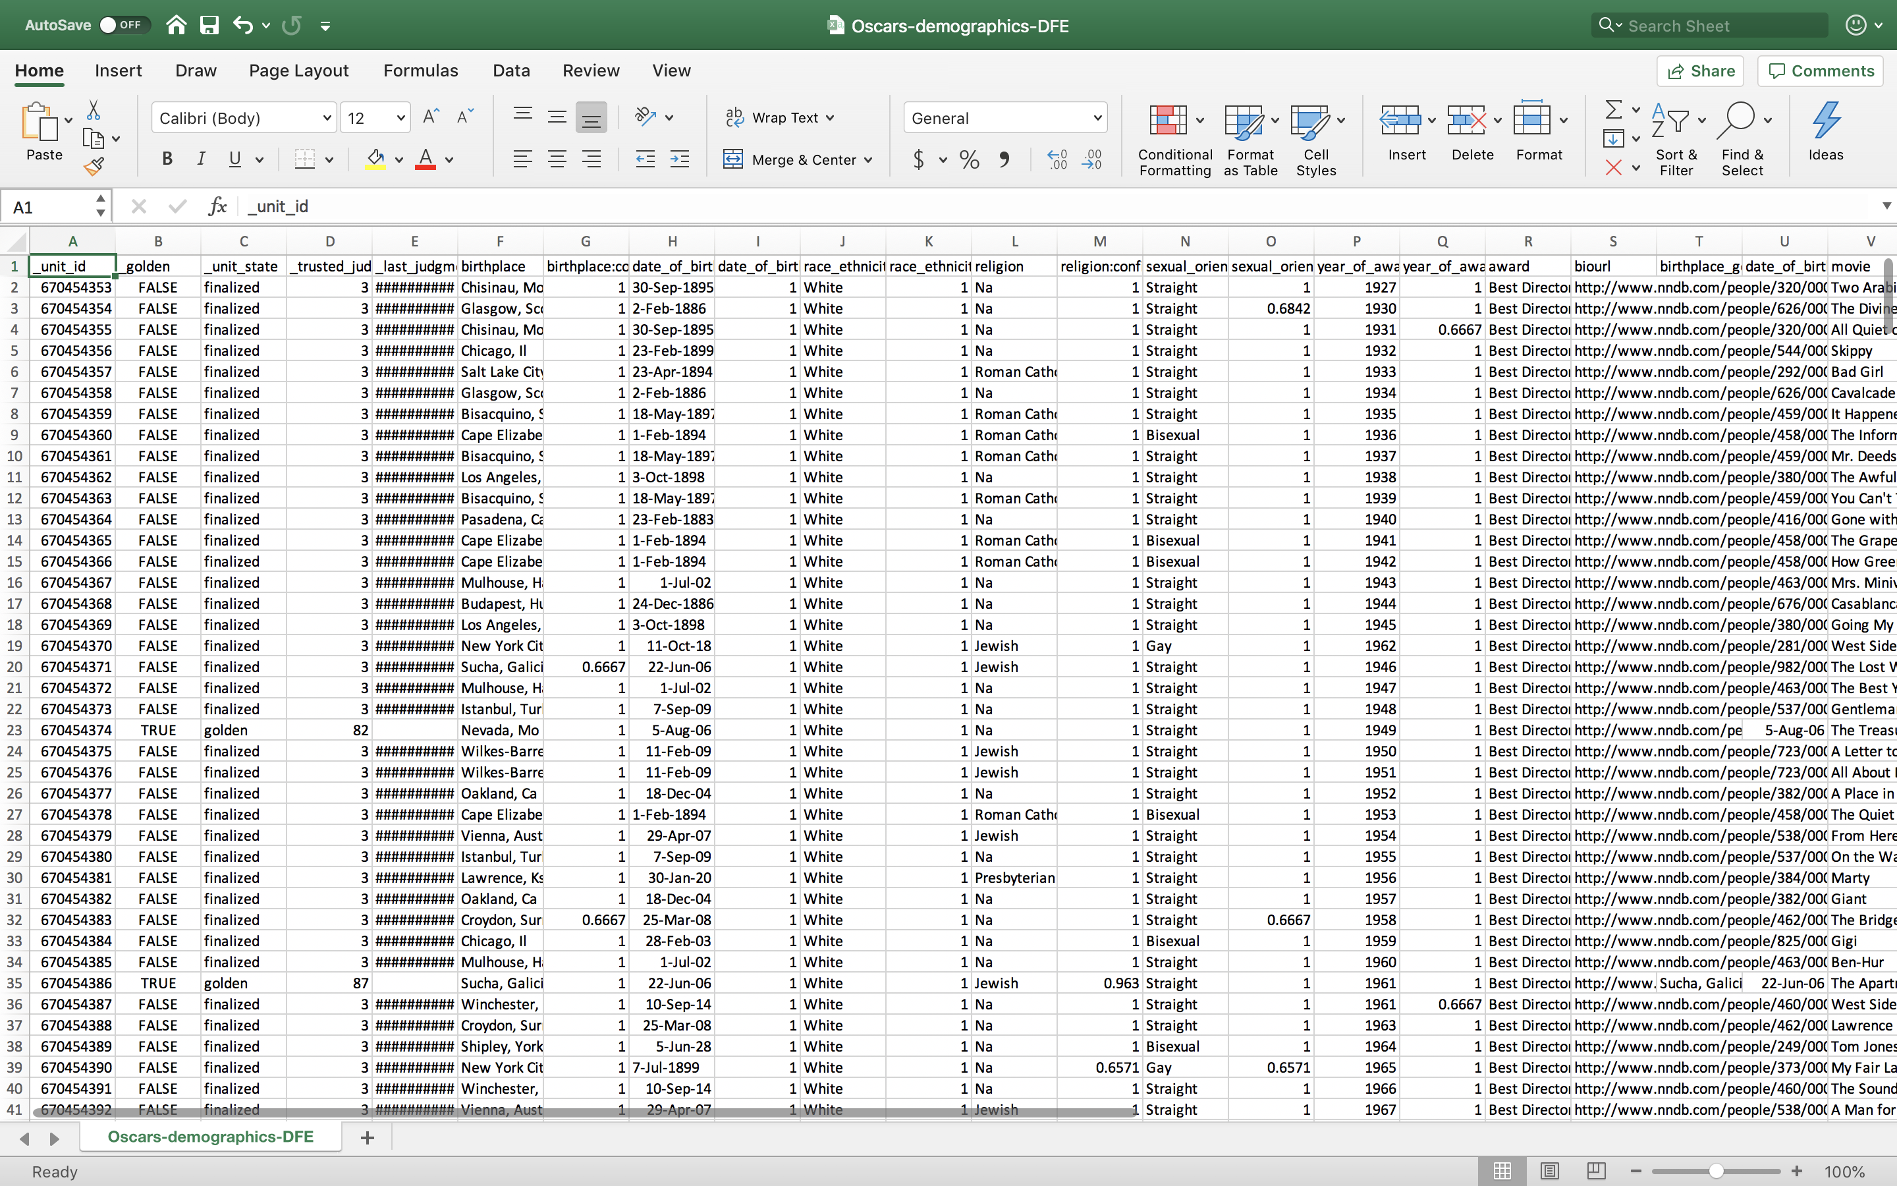
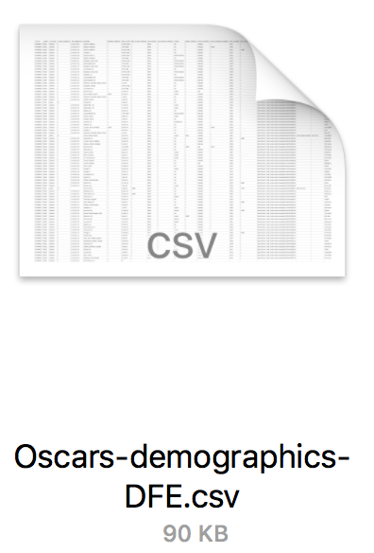
DATA DESCRIPTION
(441,27)

Slide 4
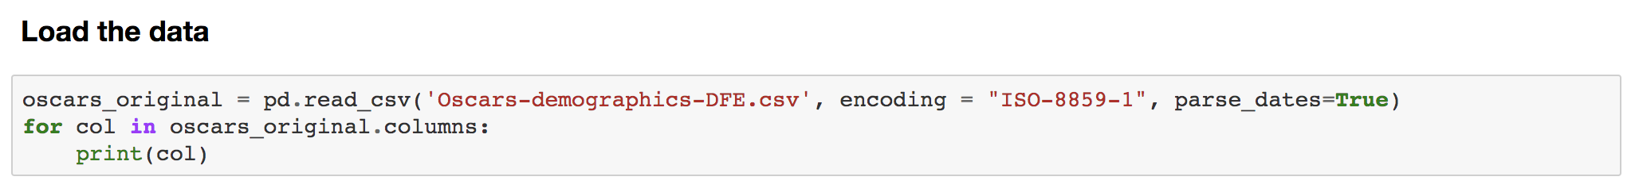
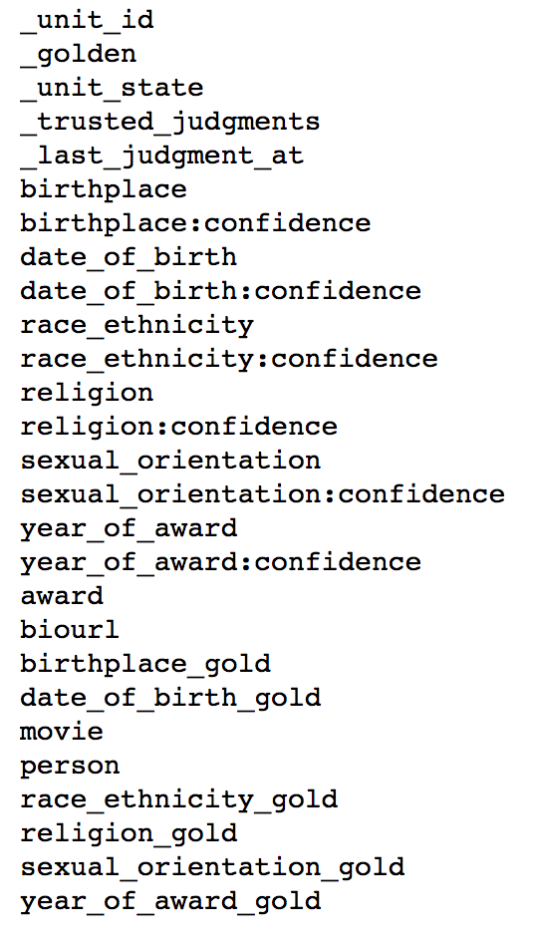
DATA DESCRIPTION

Slide 5
DATA DESCRIPTION
Data types
NUMERICAL
Continuous : _unit_id, _last_judgement_at_ , birthplace:confidence, date_of_birth, date_of_birth:confidence, race_ethnicity:confidence, religion:confidence, sexual_oridentation:confidence, year_of_award:confidence, year_of_award_gold
Discrete: _trusted_judgements, year_of_award
CATEGORICAL
Nominal : _golden, _unit_state, birthplace, race_ethnicity, religion, sexual_oridentation, award, birthplace_gold, date_of_birth_gold, movie, person, race_ethnicity_gold, religion_gold, sexual_orientation_gold,
Ordinal:
Free: biourl

Slide 6
DATA DESCRIPTION
Questions to answer
1. How are Oscars winners distributed by race & ethnicity?
2. How are Oscars winners distributed by gender?
3. Where are most of the winners from?
4. Which month were most of the winners born in?
5. How likely is it to win both the Oscars and the Golden Globe?
6. How old were they when they first won the Oscars?
7.How many people won more than once?

Slide 7
02
DATA PREPARATION

Slide 8
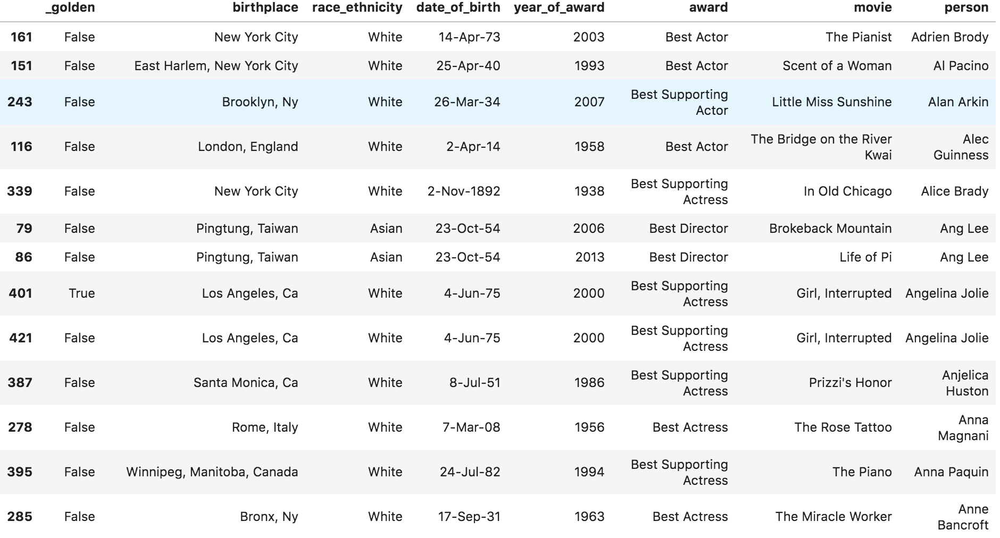
DATA PREPARATION
1. Construct a new data frame that contains only the columns of interest

Slide 9
DATA PREPARATION
1. Construct a new data frame that contains only the columns of interest

Slide 10
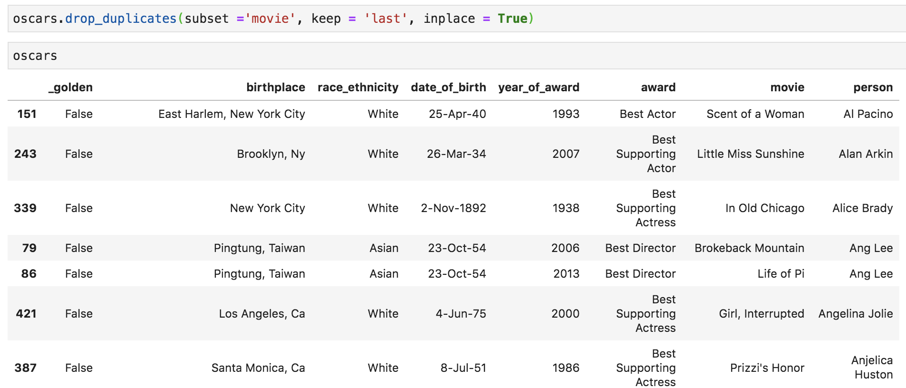
DATA PREPARATION
2. Remove the duplicated rows
.drop_duplicates()

Slide 11
03
DATA ANALYSES

Slide 12
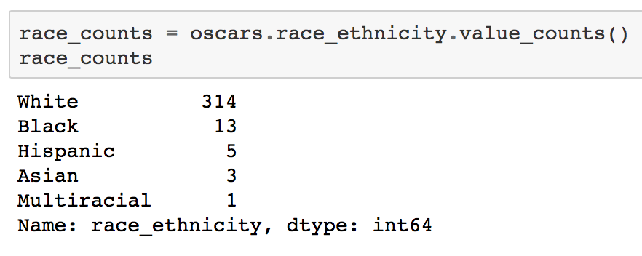
DATA ANALYSES
1. Oscars Winners by Race and Ethnicity

Slide 13
DATA ANALYSES
1. Oscars Winners by Race and Ethnicity

Slide 14
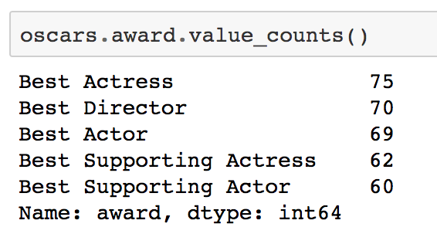
DATA ANALYSES
2. Oscars Winners by Award Category (Gender)

Slide 15
DATA ANALYSES
2. Oscars Winners by Award Category (Gender)

Slide 16
DATA ANALYSES
2. Oscars Winners by Award Category (Gender)
What is the gender ratio?

Slide 17
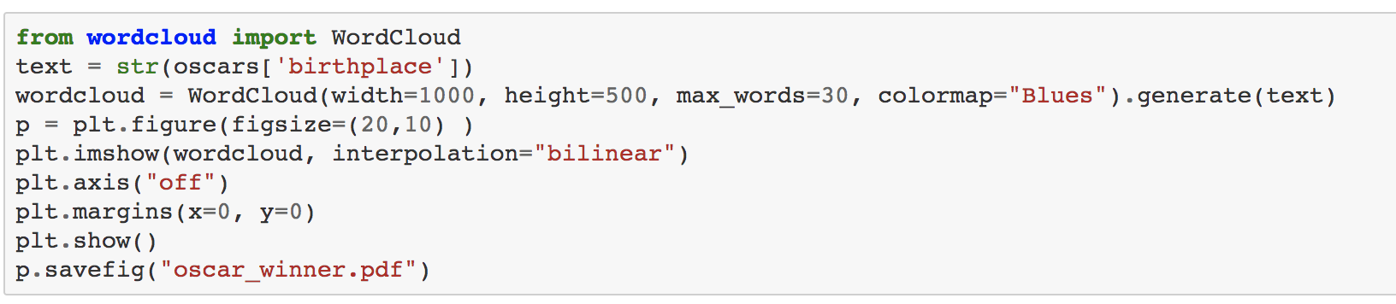
DATA ANALYSES
3. Where are most Oscars winners from?

Slide 18
DATA ANALYSES
3. Where are most Oscars winners from?

Slide 19
DATA ANALYSES
3. Where are most Oscars winners from?
London
New York
Brooklyn
Ca

Slide 20
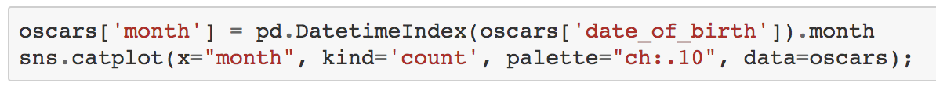
DATA ANALYSES
4. Which month were most Oscars winners born in?

Slide 21
DATA ANALYSES
4. Which month were most Oscars winners born in?
.DatetimeIndex()

Slide 22
DATA ANALYSES
4. Which month were most Oscars winners born in?

Slide 23
DATA ANALYSES
4. Which month were most Oscars winners born in?
April
December

Slide 24
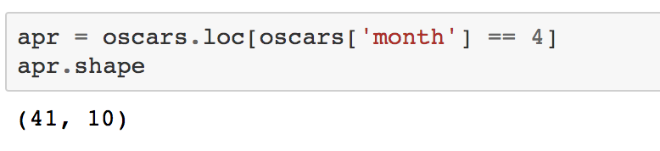
DATA ANALYSES
4. Which month were most Oscars winners born in?
April
December

Slide 25
04
TAKEAWAYS

Slide 26
TAKEAWAYS
Load data encoding
Time Data Parsing
Filtering a column based on value
Future work: map

Slide 27
THANKS!

